Slide 1
Learning basic command

Slide 2
Understanding file permission
Why Are File Permissions Important ?
Keep users from accessing other users’ private files
To protect important system files

Slide 3
Understanding file permission
permissions bits:
rwx rwx rwx
Owner’s| Group | Others
r = read w = write x = execute
For Files:
"Read" means to be able to open and view the file
"Write" means to overwrite or modify the file
"eXecute" means to run the file as a binary files are executable only if they are programs and shell scripts, not useful for data files.
For Directories:
"Read" means to be able to view the contents of the directory
"Write" means to be able to create new files/directories or delete files/directories within the directory
"eXecute" means to be able to "Change Directory" (cd) into the directory = permission to access the directory.

Slide 4
Understanding file permission
How to view the permission for a file or directory?
$ ls –al
Default permission for an new file :
rw: by the owner of the file.
r: by group members and others.
rw- r-- r—
Default permission for an new directory:
rwx: by the owner of the directory .
rx: by group members and others.
rwx r-x r-x

Slide 5
Understanding file permission
Only the owner of a file can change its permission.
How to set file permission?
Use the command chmod(change file mode bits).
chmod has two notations:
Numeric (Octal) Notation.
Symbolic Notation

Slide 6
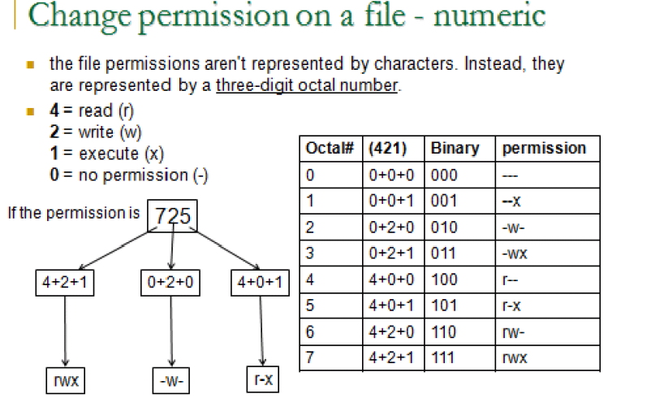

Slide 7
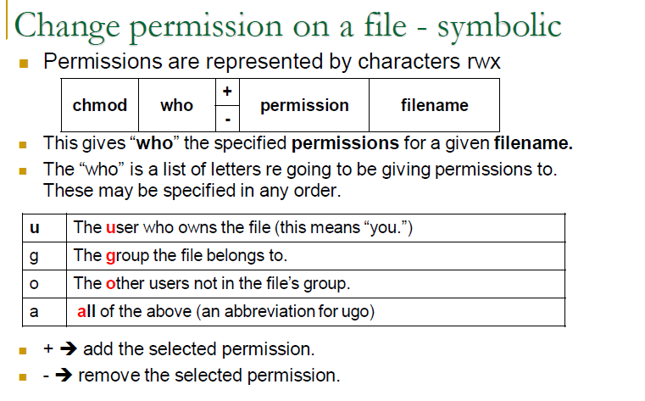

Slide 8
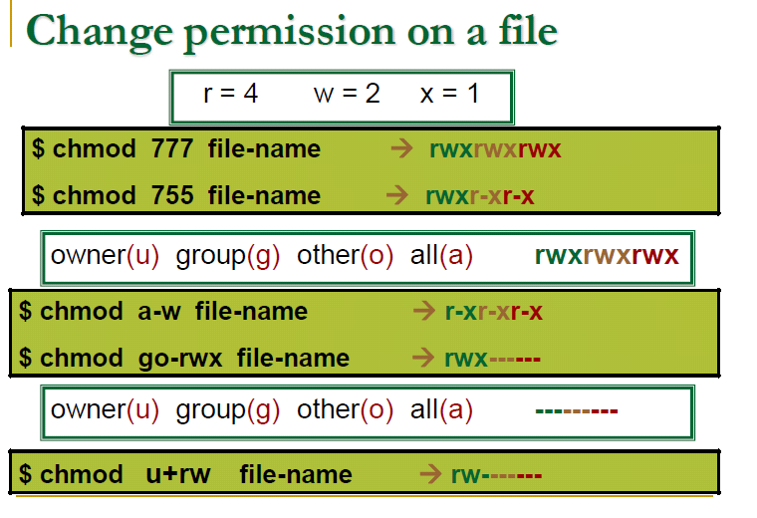

Slide 9
Understanding file permission
1. Add single permission to a file/directory
$ chmod u+x filename
2. Add multiple permission to a file/directory
$ chmod u+r,g+x filename
3. Remove permission from a file/directory .
$ chmod u-rx filename
4. Change permission for all roles on a file/directory
$ chmod a+x filename

Slide 10
Evaluation
1 - Create new directory
2-Change directory Permissions using Numeric Notation.
Owner >> read , write , execute
Group >>read , write
Other >> read
3-Create new file inside the directory
4- Change file Permissions using Symbolic Notation
All (Owner+group+other)>> read
5-view the permission for a file and directory

